Slide 1
Creating an Individualized
Robust Systematic Approach (RSA) Plan
September 26, 2019 - OSU webinar for Small/Very Small Plant Owners
Sallee J. Dixson, DVM, MS
Supervisory Public Health Veterinarian-Relief
USDA-FSIS-Office of Field Operations
Eugene (OR) Circuit, Denver District

Slide 2
A Little About Me
DVM degree in 1998; MS in 2003
Positions held with FSIS since Dec. 2001
  Relief SPHV in Lawrence and Denver Districts
  In-plant IIC/SPHV in Lawrence District
  DVMS for Lawrence District*
  Humane Handling (HH) Enforcement Coordinator in DC*
  FLS – Eugene Circuit, Denver District
  * total of 5 years with primary focus on HH

Slide 3
Presentation Contents
RSA Development History within FSIS
Creating Your RSA Plan
Combined Q & A Session –
  with Ben Meyer of Revel Meat Company

Slide 4
RSA Development History
Federal Register – Docket # 04-013N
  (September 9, 2004): SA introduced
FSIS Directive 6900.2, Rev.2 (2011): RSA introduced
FSIS 2013 Compliance Guide: Systematic Approach to HH of Livestock & RSA information
New PHIS Task (2017) - Notice 04-17 (2017), reissued as Notice 34-18 (2018): Assessment - Verification Review of RSA for HH/Slaughter

Slide 5
Federal Register Notice (Sept. 2004)
“Humane Handling and Slaughter Requirements and the Merits of a Systematic Approach To Meet Such Requirements”
Reasons for issuance
Four parts to a systematic approach
  Initial assessment
  Facility design and handling practices
  Periodic evaluations of handling and stunning
  Improvements made when determined necessary

Slide 6
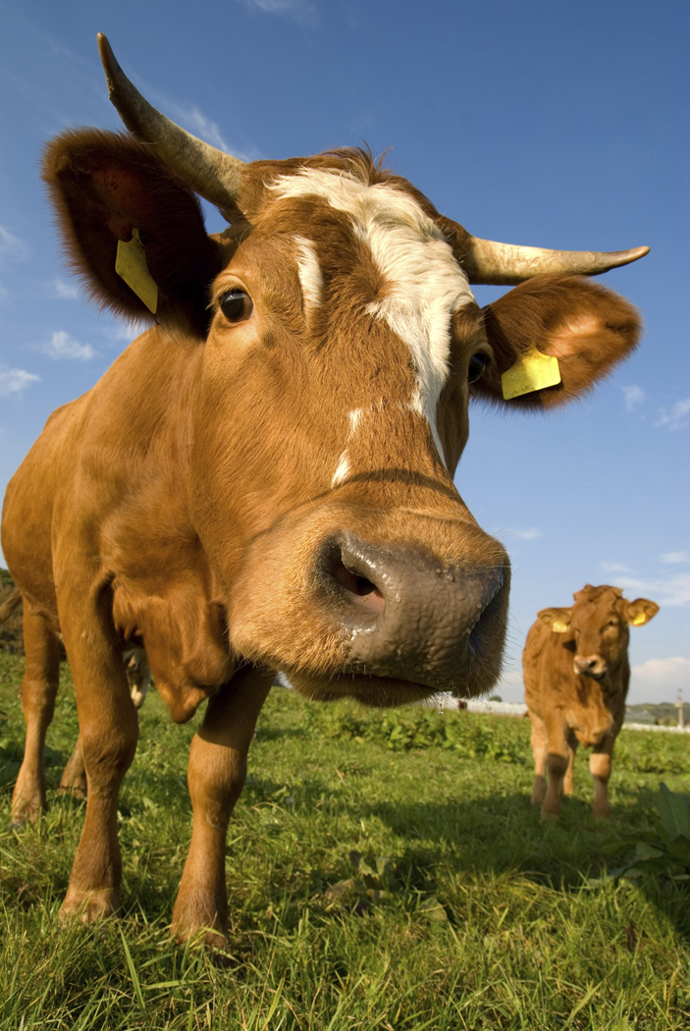
Directive 6900.2, Rev. 2 (Aug. 2011)
“Humane Handling and Slaughter of Livestock”
Directive reissued to provide updated instructions to IPP including introduction of:
  Do no further harm concept, and
  Robust Systematic Approach – written animal handling plan

Slide 7
Directive 6900.2, Rev. 2 – cont’d
General information in Dir. 6900.2, Rev. 2
  No regulatory requirement for written SA to HH
  Noncompliance records (NRs) will not be issued for failure to follow a written RSA plan unless there is an identifiable failure to meet one of the Humane Handling regulations
  Voluntary development/implementation of a ‘Robust’ SA regulatory discretion in the enforcement response to an egregious event

Slide 8
What is Regulatory Discretion?
Option to implement lesser enforcement level
Dir. 6900.2, Chap. VII, Part IV, Section C
  If there is an Egregious HH incident –
  IPP may recommend* NOIE if:
    No recent HH enforcements
    Consistently meeting HH regulatory requirements
    Operating under written Robust SA plan
    Robustness demonstrated through effective/documented implementation
    * Final decision is made at the district office level

Slide 9
Directive 6900.2, Rev. 2 – cont’d
Attachment 3 to Dir. 6900.2, Rev. 2 -Addresses development of a written RSA plan that:
  Is tailored to a specific establishment – must address all four steps of a SA to HH
  (per 2004 Federal Register Notice)
  Describes procedures to be implemented
  Describes monitoring records to be kept
  Describes actions to be taken when a failure to effectively implement is identified

Slide 10
FSIS 2013 Compliance Guide: Systematic Approach to HH of Livestock
Compares (pgs. 6 – 8) SA vs. RSA
Addresses creating (pgs. 10 - 11) an RSA
Attach. 2: guidance tool for initial assessment
Attach. 3: sample RSA plan
Attach. 4: sample HH Monitoring Record

Slide 11
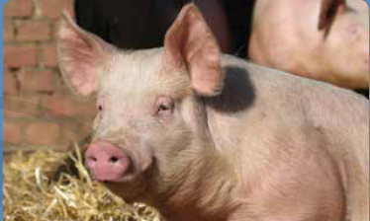
Notice 04-17 (2017) – reissued as Notice 34-18 (2018)
Monthly PHIS Task by S/PHV
Assessment and Verification of an establishment’s RSA for HH/Slaughter
  PHIS generates the Questionnaire used
  Note: if an establishment does not have a RSA plan the questionnaire is completed with a “No” answer to Q1
  When task is completed, MOI is provided to: DVMS, FLS, plant owner/manager

Slide 12
Assessment & Verification Review of RSA Task Questionnaire
1. Does this establishment have a written Systematic Approach to humane handling and slaughter? Y or N
(If Y, PHV will answer rest of questions in survey. If N, survey closes out)
2. Is the systematic approach and all records associated with it available for inspection program personnel review? Y or N
3. Does the establishment have written procedures that they effectively implement to stay in compliance with humane handling regulations? Y or N
4. Does the establishment keep written (or electronic) records that demonstrate that the program is being implemented as written? Y or N
5. Does the establishment keep records that demonstrate the program is effectively preventing identified potential noncompliance? Y or N
6. Does the establishment log/record corrective actions they take when it fails to implement the program as written or fails to prevent a noncompliance? Y or N
7. At the time of this task, does this establishment have a robust systematic approach to humane handling and slaughter? Y or N

Slide 13
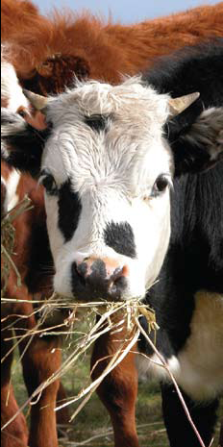
Creating Your RSA Plan
Assess what you do now
  Write it down/Make a flow chart
Review RSA requirements
  Compare to what you do now
  Note any missing components
Develop written plan &
Design monitoring records
Verify written plan & records

Slide 14
Creating Your RSA Plan - cont’d
Assess current process - WRITE IT DOWN!
  First walk through on a non-slaughter day
    Make a list of process steps starting at unloading
    Follow process through to bleed-out area
  Next take your first list and observe on a slaughter day – adding/correcting as needed
  Create a ‘clean’ copy (e.g., Word document)
    Give the clean copy to another person
    Have them follow process & write down Comments

Slide 15
Creating Your RSA Plan – cont’d
Review the 7 elements for an RSA Plan
  The 4 from Fed. Register Notice on HH SA
    Initial Assessment for areas of potential concern
    Design facilities/implement practices for good HH
    Evaluate process periodically for effectiveness
    Make facility/process changes based on evaluation
  The 3 found in Dir. 6900.2, Rev. 2, for RSA
    Written procedures for SA to HH & slaughter
    Written monitoring records
    Both procedures/records available for FSIS review

Slide 16
Creating Your RSA Plan – cont’d
Using the FSIS Compliance Guide for a SA to the HH of Livestock (pgs. 6-11), compare:
  The steps of your current process to
  The elements for an RSA plan, and
  Make note of any missing elements then – using the tools in the Guide (Attach. 2, 3 & 4):
    Conduct an assessment
    Create a written plan specific to your process, and
    Develop monitoring records

Slide 17
Creating Your RSA Plan – cont’d
Suggestions for using the Guide’s tools:
  Do not get overwhelmed – in all likelihood the Tools are more detailed than needed for Small/Very Small slaughter establishments
  When writing your RSA Plan – keep it as simple as possible to start.
  Note: By this point you may be asking -
  Do I do it myself or seek outside help?

Slide 18
Creating Your RSA Plan – cont’d
Suggestions – cont’d
  When developing your Monitoring Records, group based on area, who will do monitoring, or how often will monitoring occur. Note: also consider ease of reviewing – by you & FSIS
  Set-up a schedule to review/assess your process & records on a sliding time frame (i.e., longer & longer between) until you reach a ‘standard’ time frame
  When complete, notify FSIS IPP you want a review to determine if your plan meets the definition of an RSA
    Input will be provided by DVMS & Circuit level supervisors

Slide 19
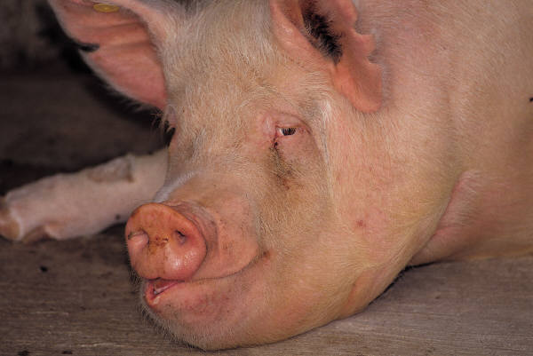
Resources – go to FSIS website: www.fsis.usda.gov type “humane handling” in Search then click on first item HH Resource page
FSIS Compliance Guide for SA (2013)
  Pages 6 - 11
  Attachment 2
  Attachment 3
  Attachment 4
Dir. 6900.2, Rev. 2
  Chapter I, Section VII
  Chapter VII, Section IV
  Attachment 3
FSIS Notice 34-18

Slide 20
Thank you for your time and attention.
Sallee J. Dixson, DVMS, MS
SPHV with USDA-FSIS-OFO
sallee.dixson@usda.gov
Gov. Cell: 541-429-9862

Slide 21
Questions?

